Slide 1
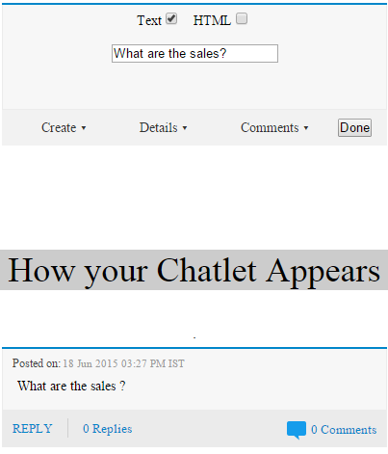
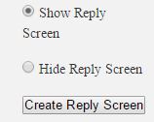

Chatlet creator user manual
You can use this bot to create more advanced chatlets and customize them using HTML code.
step1: Join Bot Chatlet creator
Step2: Type create in the Bot and click on chatlet button posted by bot
You can design your chatlet by checking on HTML and writing chatlet in HTML code.
If you check on Text this field will appear.In this fields you can write your question
Click on dropdown 'Create' and select option 'Create Reply Screen' to create the chatlet. You can Shoe or hide Reply screen/Detail/comments.
You can see here how your chatlet will look

Slide 2
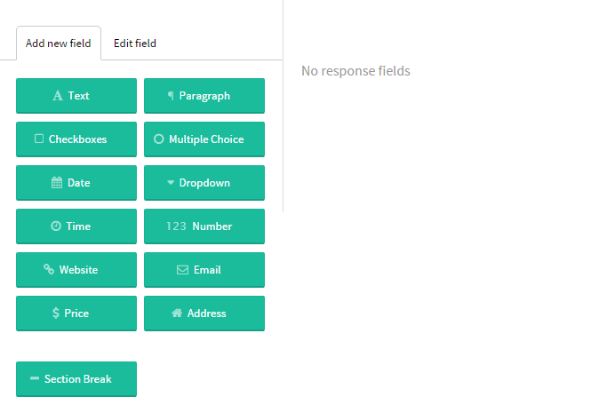
step2: Click on dropdown 'Create' and go to option 'Create Reply Screen' to create the chatlet. You will reach this page
You can add these colored tabs by drag and dropping on right blank space

Slide 3
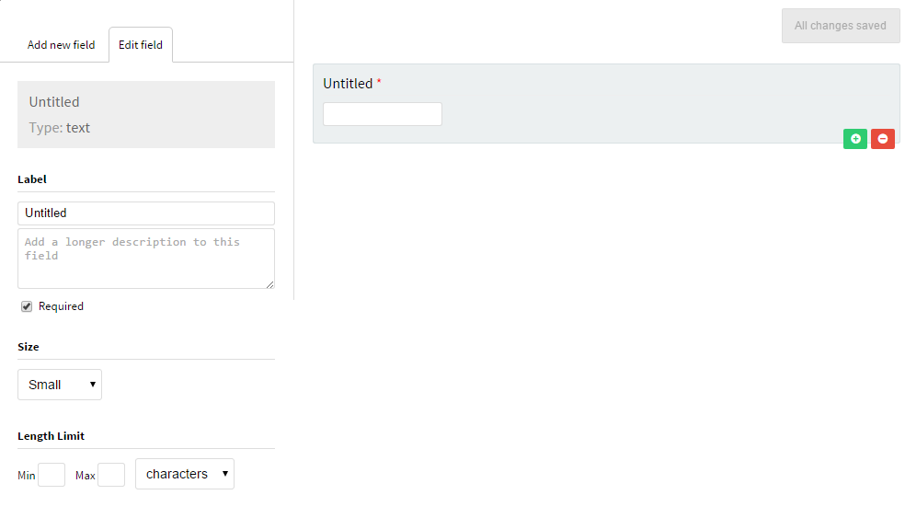
Example: Drag Text field you will get this
Add and remove same field from here
You can edit your fields from here

Slide 4
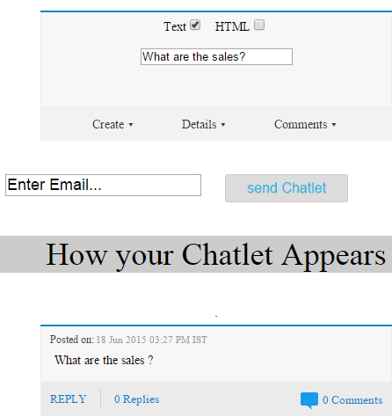
step3: Once you are done with designing your replies screen go back to previous tab and click on 'Done'
1.After clicking on option 'Done' this field will appear write email and click on send

